Slide 1
LECTURE - 7

Slide 2
LEAST SQUARES CURVE FITTING

Slide 3
Motivation
Given a set of experimental data
x | 1 | 2 | 3
y | 5.1 | 5.9 | 6.3
The relationship between x and y may not be clear
we want to find an expression for f(x)
1 2 3

Slide 4
KEPPLER THIRD LAW OF PLANETARY MOTION

Slide 5
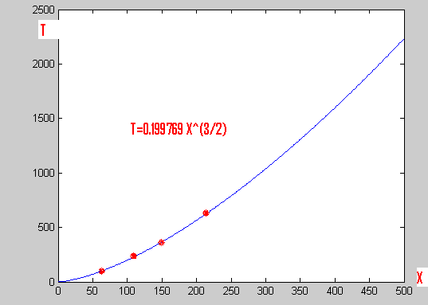

Slide 6
Curve Fitting
Given a set of tabulated data, find a curve or a function that best represents the data.

Slide 7
EXPERIMENTAL ERROR
Given
x_{i} | x₁ | x₂ | …. | x_{n}
y_{i} | y₁ | y₂ | …. | y_{n}
The form of the function is assumed to be known but the coefficients are unknown.
The difference is assumed to be the result of experimental error

Slide 8
ERROR

Slide 9
LEAST- SQUARES LINE
INTRODUCTION

Slide 10
LEAST- SQUARES LINE
The least square line y=f(x)=Ax+B is the line that minimizes RMS-error

Slide 11
FINDING LEAST-SQUARES LINE
Please write down the black board summary

Slide 12
Determine the Unknowns

Slide 13
Determine the Unknowns

Slide 14
Remember

Slide 15
How to find constant in y=ax+b

Slide 16
Example 1

Slide 17
Example 1
k | 1 | 2 | 3 | sum
x_{k} | 1 | 2 | 3 | 6
y_{k} | 5.1 | 5.9 | 6.3 | 17.3
x_{k}² | 1 | 4 | 9 | 14
x_{k} y_{k} | 5.1 | 11.8 | 18.9 | 35.8

Slide 18
Example 1

Slide 19
Power Fit

Slide 20
Polynomial Fitting

Slide 21
EXAMPLE
Find the least –squares parabola
for the set of data:-

Slide 22
EXAMPLE

Slide 23
EXAMPLE
Using The derived Normal Equations we get
16A+20B=50
20B=6
20A+4C=50

Slide 24
Polynomial Wiggle
It is tempting to use a least-squares polynomial to fit data that are nonlinear. But if the data do not exhibit a polynomial nature, the resulting curve may exhibit large oscillations. This phenomenon is called Polynomial Wiggle.

Slide 25
10 th order Polynomial Curve Fitting

Slide 26
Example 2
x | 0.24 | 0.65 | 0.95 | 1.24 | 1.73 | 2.01 | 2.23 | 2.52
y | 0.23 | -0.23 | -1.1 | -0.45 | 0.27 | 0.1 | -0.29 | 0.24

Slide 27
Example 2

Slide 28
Example 2

Slide 29
How do you judge performance?

Slide 30
Multiple Regression
Example:
Given the following data
It is required to determine a function of two variables
f(x,t) = a + b x + c t
to explain the data that is best in the least square sense.
t | 0 | 1 | 2 | 3
x | 0.1 | 0.4 | 0.2 | 0.2
f(x,t) | 3 | 2 | 1 | 2

Slide 31
Solution of Multiple Regression
Construct , the sum of the square of the error and derive the necessary conditions by equating the partial derivatives with respect to the unknown parameters to zero then solve the equations.
t | 0 | 1 | 2 | 3
x | 0.1 | 0.4 | 0.2 | 0.2
f(x,t) | 3 | 2 | 1 | 2

Slide 32
Solution of Multiple Regression

Slide 33
NONLINEAR LEAST SQUARE PROBLEMS
EXAMPLES

Slide 34
Linearization Method
x | 1 | 2 | 3
y | 2.4 | 5. | 9
Given

Slide 35
Inconsistent System of Equations

Slide 36
Inconsistent System of Equations Reasons
Inconsistent equations may occur because of errors in formulating the problem, errors in collecting the data or computational errors.
Solution if all lines intersect at one point

Slide 37
Inconsistent System of Equations Formulation as a least squares problem

Slide 38
Solution

Slide 39
Solution

Slide 40
Example (Linearization Method)
x | 1 | 2 | 3
y | 0.23 | .2 | .14
Given

Slide 41
Solution

